Slide 1


CHATBOT FOR HEALTHCARE APPOINTMENT
DINESHKUMAR VD
422521104304
University College Of Engineering Villupuram
Computer Science And Engineering

Slide 2


TABLE OF CONTENT
Problem Statement
Result
Proposed Solution
Conclusion
System Development Apporach
References
Algorithm & Development

Slide 3
Inefficient appointment scheduling and assistance processes in healthcare, leading to delays and frustration for both patients and healthcare providers
PROBLEM STATEMENT
The end users of the healthcare appointment scheduling system project include patients, healthcare providers, administrative staff, hospital or clinic management, IT support staff, system administrators, and patients' families or caregivers
WHO ARE THE END USERS ?

Slide 4


Development of a healthcare chatbot to automate appointment scheduling, management, and assistance tasks, aiming to improve efficiency and enhance the patient experience.
PROPOSED SOLUTION

Slide 5

SYSTEM DEVELOPMENT APPROACH
Our project's development approach involves a systematic methodology, covering essential steps from data collection to model architecture design and training. We start by gathering diverse datasets containing intents, user queries, and responses related to healthcare appointments. These datasets undergo preprocessing and are used to train a sophisticated model capable of effectively understanding and responding to user inquiries.
DATA COLLECTION
MODEL ARCHITECTURE DESIGN
Curating comprehensive datasets comprising various intents, user queries, and corresponding responses relevant to healthcare appointments
Designing a sophisticated model architecture integrating key components such as Embedding, LSTM, and Dense layers to enable effective comprehension and response to user queries about healthcare appointments.
PREPROCESSING TECHNIQUES
Employing robust preprocessing methods like tokenization, sequence padding, and one-hot encoding to prepare the data for model training

Slide 6
ALGORITHM
Advanced NLP Techniques
Our project harnesses advanced Natural Language Processing (NLP) techniques to empower a chatbot tailored for healthcare appointment management. Through methods like tokenization, sequence padding, and LSTM-based classification, the chatbot adeptly interprets user queries and furnishes relevant responses. Furthermore, optimization via the Adam optimizer and categorical cross-entropy loss function enhances the chatbot's classification accuracy.
Delving into techniques like tokenization and sequence padding, we prepare user queries for effective processing, laying the groundwork for accurate comprehension by the chatbot.
LSTM-based Classification
Delving into techniques like tokenization and sequence padding, we prepare user queries for effective processing, laying the groundwork for accurate comprehension by the chatbot.
Model Training Optimization
Through optimization using the Adam optimizer and categorical cross-entropy loss function, we refine the chatbot's training process to maximize classification accuracy, thereby bolstering its efficacy in addressing healthcare appointment queries.

Slide 7
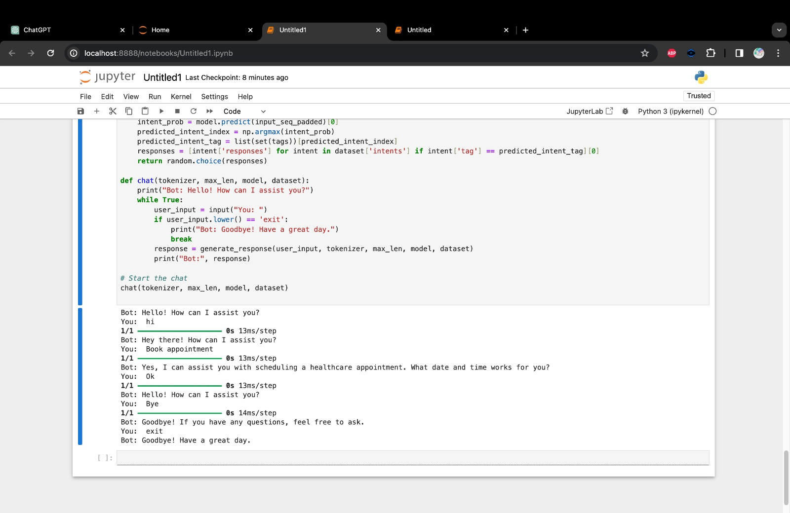
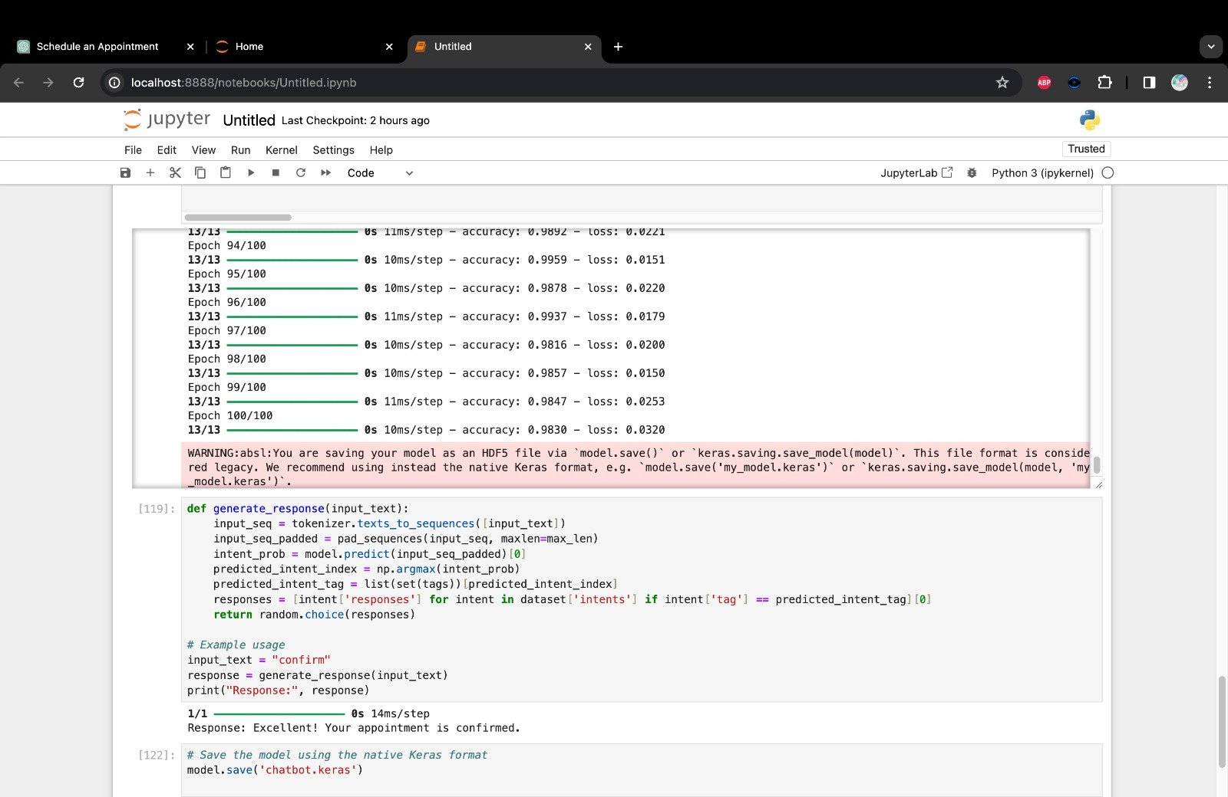
RESULT
The chatbot model demonstrates high accuracy and effectiveness in categorizing user queries, leading to streamlined appointment processes and improved patient satisfaction.

Slide 8
The implementation of the healthcare chatbot offers a transformative solution, revolutionizing appointment management and assistance in healthcare delivery.
CONCLUSION

